Slide 1


AI-DRIVEN PERSONALIZED CONTENT RECOMMENDATION SYSTEM FOR E-COMMERCE WEB APPLICATIONS
Mohammad Vaish (2000100548)
Adnan Sheikh (2000100750B)

Slide 2
TABLE OF CONTENTS
01
02
03
04
05
About the Project
Scope/Key Features
Resources
Development
Project Modules

Slide 3
01
ABOUT THE PROJECT

Slide 4
INTRODUCTION
The project focuses on developing an AI-powered recommendation system for e-commerce platforms. This system aims to personalize product suggestions and content based on user preferences, behaviors, and interactions. By leveraging machine learning (ML) and natural language processing (NLP), the system will offer tailored recommendations that dynamically adapt to each user's unique shopping habits. The goal is to enhance customer engagement, boost user satisfaction, and ultimately increase sales on the platform.
OBJECTIVE
The primary goal of this project is to create an Al-powered recommendation system that dynamically personalizes product suggestions and content for users on e-commerce platforms. This system aims to enhance customer engagement, improve user satisfaction, and increase sales by offering tailored experiences based on individual preferences and behavior.

Slide 5
02
SCOPE/KEY FEATURES

Slide 6
KEY FEATURES
Admin Panel
E-commerce interface
Dashboard
AI based recommendations
Responsive UI

Slide 7
03
RESOURCES

Slide 8
HARDWARE REQUIREMENTS
SOFTWARE REQUIREMENTS
Laptop
Frontend
8GB RAM, i5
HTML, CSS, JavaScript, React.js and Tailwind CSS
OS & IDE
Backend
Windows or MacOS with VS Code
Node.js, Express.js, Python, Flask and NLP and ML
Stable Internet Connection
Database
For effective testing of internet-based features
MongoDB

Slide 9
BENEFITS
- Personalized Experience: By analyzing user behavior and preferences, the recommendation system tailors product suggestions, leading to a more personalized shopping experience. - Increased Engagement: Users are more likely to interact with products that match their interests, which can lead to higher engagement rates and longer session durations. - Boosted Sales: With better product recommendations, users are more likely to make additional purchases, thereby increasing the platform's overall sales. - Admin Control: The e-commerce admin panel allows administrators to perform CRUD (Create, Read, Update, Delete) operations on products, view purchase history, and gain insights into consumer behavior. - Efficient User Interaction: Users benefit from a streamlined shopping experience, where their preferences and past orders influence future recommendations.

Slide 10
04
DEVELOPMENT

Slide 11
TIMELINE
Design
Testing & Debugging
Week 2
Week 8
Week 1
Week 3-7
Requirement Analysis
Development

Slide 12
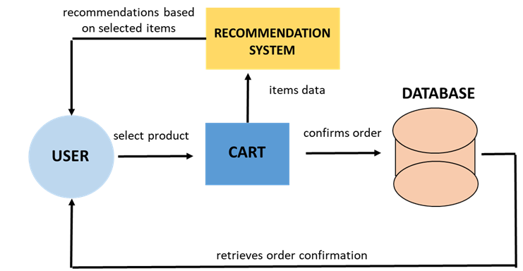
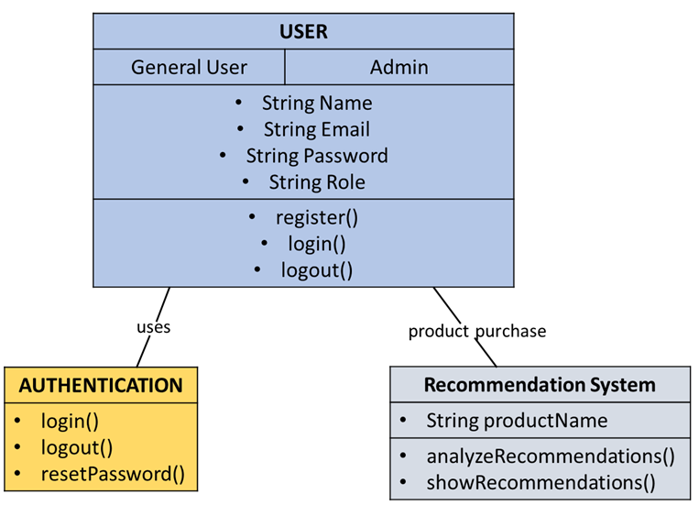
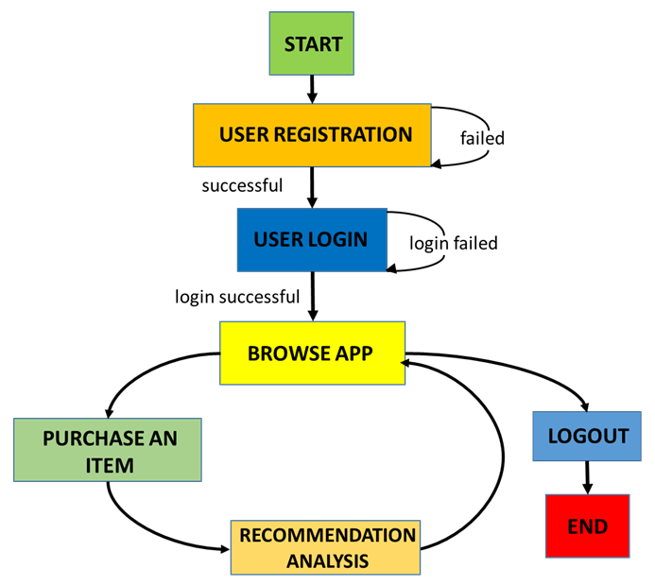
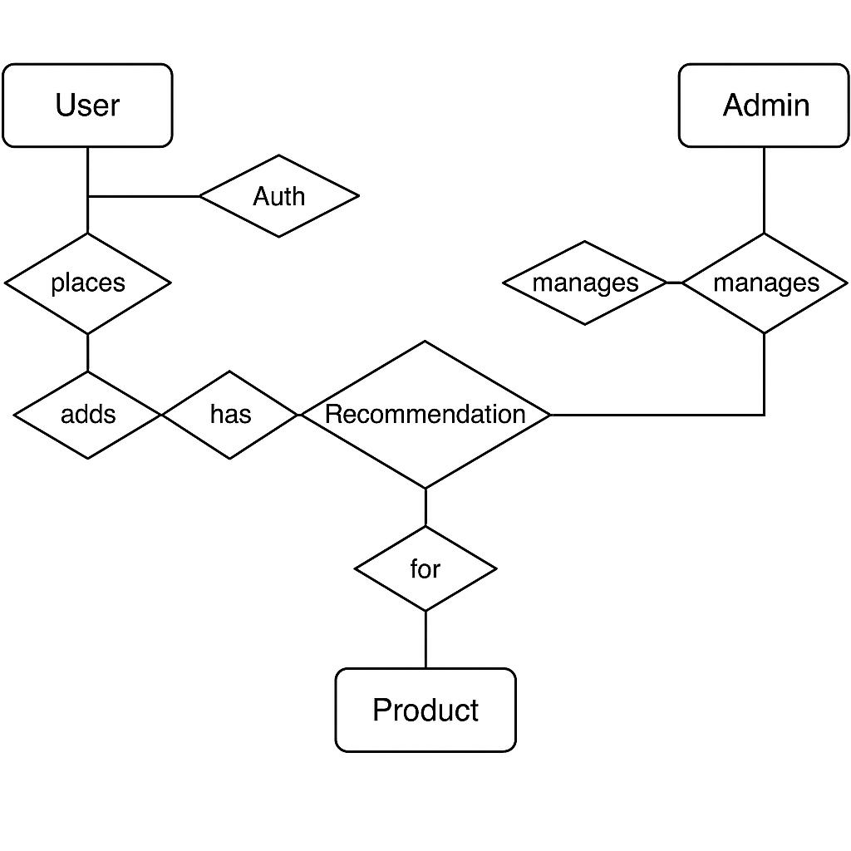
PROCESS FLOW
Data Flow Diagram
Class Diagram
Activity Diagram
Entity Relationship Diagram

Slide 13
05
PROJECT MODULES

Slide 14
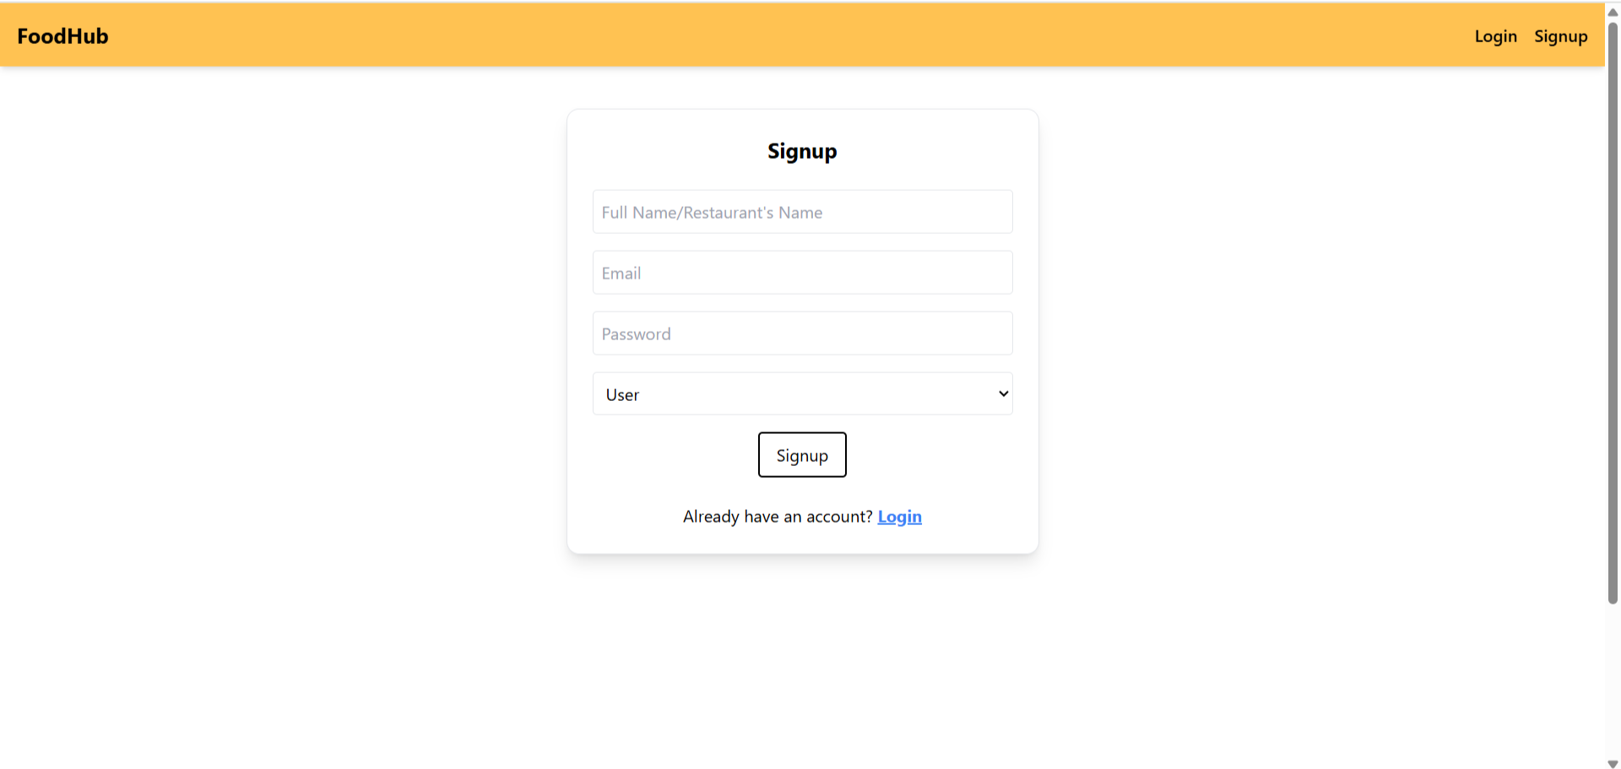
USER AUTHENTICATION MODULE
User authentication ensures secure access to the app by requiring users to sign up and log in with their credentials.

Slide 15
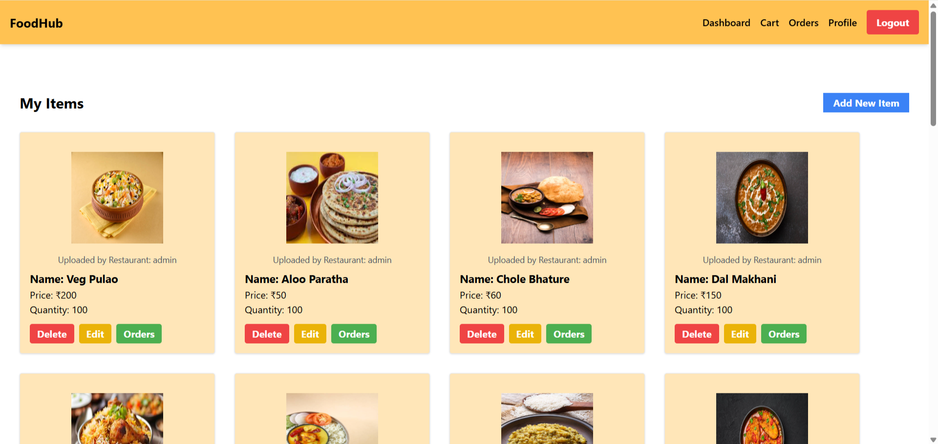
ADMIN MODULE
Products CRUD
Personalized Dashboard
Product Purchasers

Slide 16
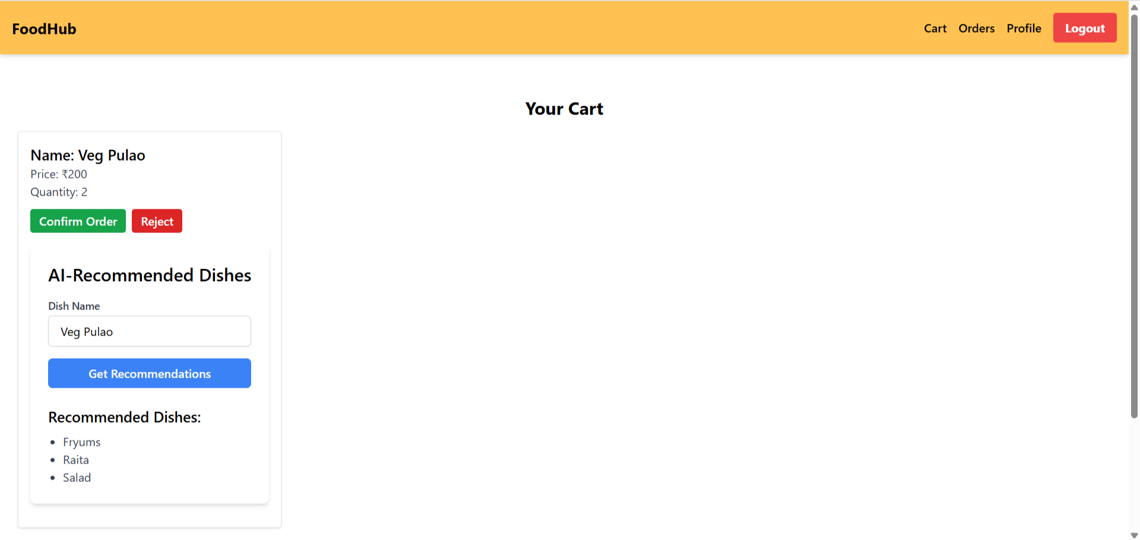
USER MODULE
Product purchasing
Cart System
Order history

Slide 17
AI RECOMMENDATION MODULE
NLP based item processing
ML based item’s Recommendation Analysis
Flask based communication

Slide 18
FUTURE SCOPE
Cross-Platform Integration
Real-Time Data Processing
Advanced Personalization
Multi-Language Support
AI-Driven Analytics

Slide 19
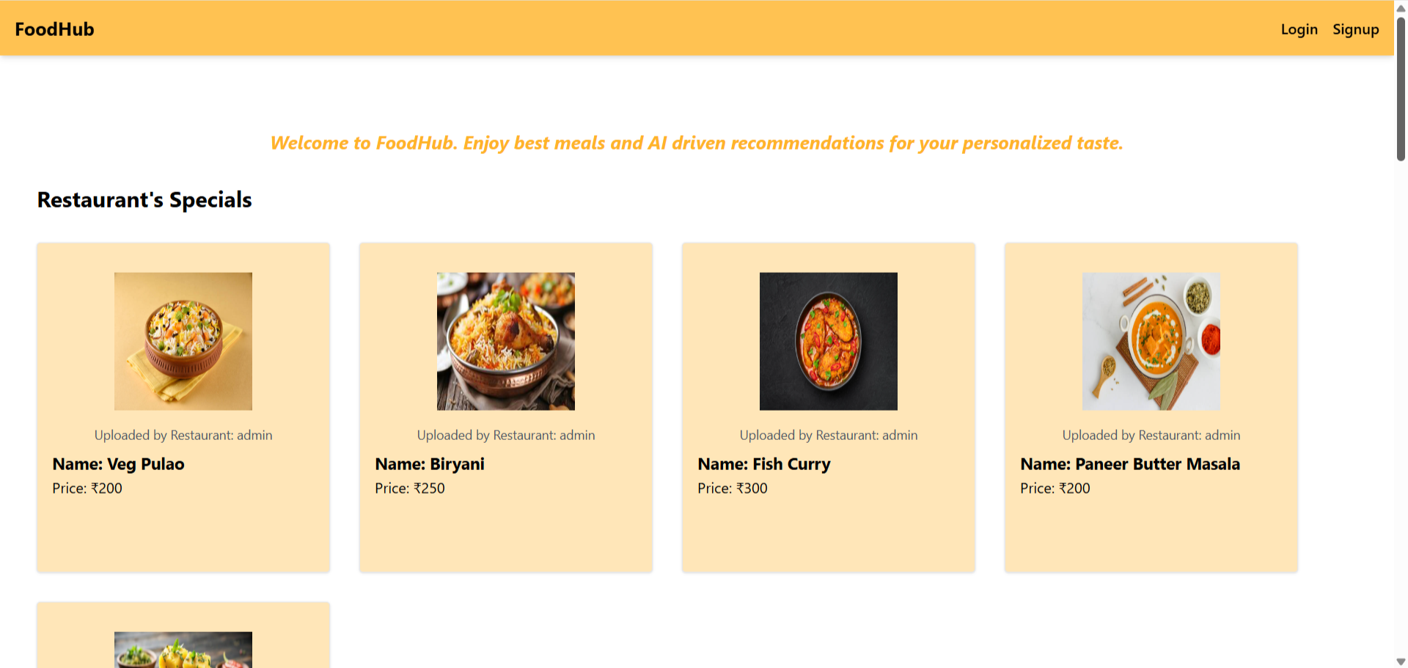
PROTOTYPE

Slide 20
This AI-powered recommendation system is a step toward revolutionizing the e-commerce experience by providing personalized product recommendations that cater to individual preferences. It not only improves user satisfaction and engagement but also supports the growth of the platform by driving higher sales and fostering customer loyalty. As the system evolves, it holds the potential to become even more sophisticated, benefiting both customers and e-commerce businesses alike.
CONCLUSION

Slide 21
THANK YOU

